Slide 1





UV-C Dose-Response Behavior of Airborne (Aerosolized) Challenge Agents I: Theoretical Foundation
Ernest R. Blatchley III^{1,2}, Mark Jongewaard³, Holger Claus⁴, Mark T. Hernandez⁵,
Shohoria Afrin Shorno¹, Christopher A. Bowers⁶
¹Lyles School of Civil & Construction Engineering, Purdue University
²School of Sustainability Engineering & Environmental Engineering, Purdue University
³LTI Optics, LLC
⁴A3 Lighting Consulting
⁵Department of Civil, Environmental and Architectural Engineering, University of Colorado
⁶Department of Civil, Construction and Environmental Engineering, North Carolina St. Univ.

Slide 2
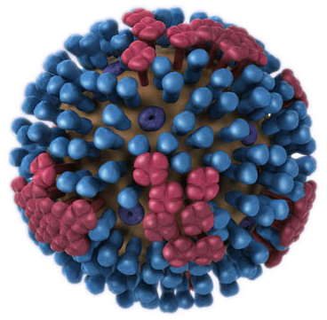
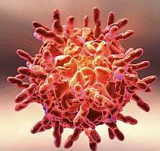
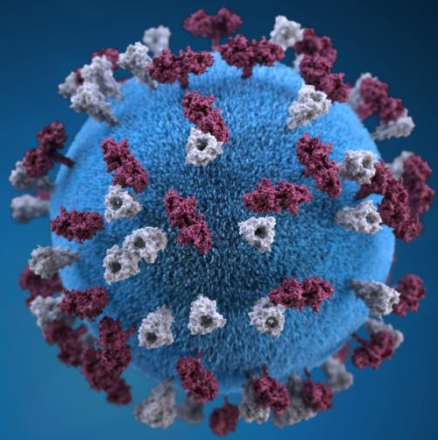
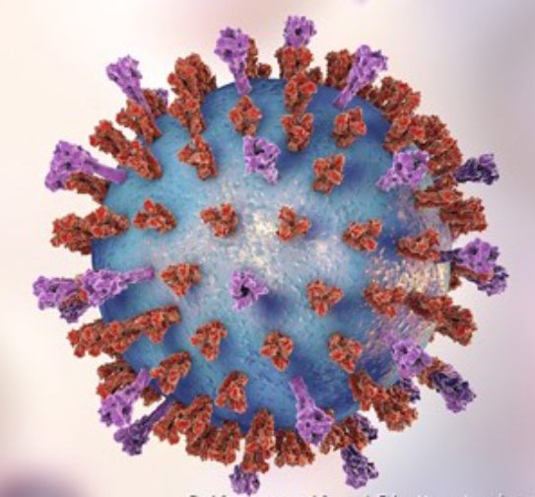
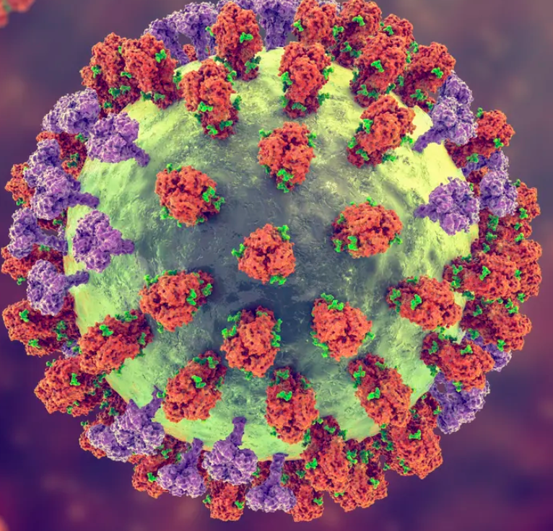
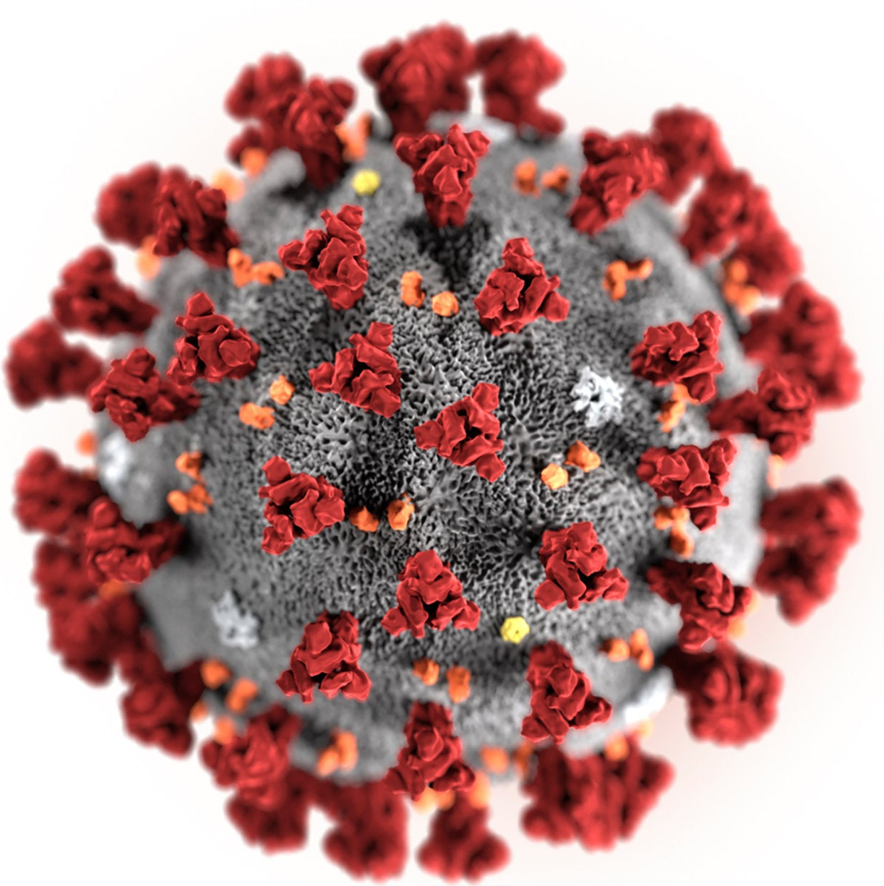
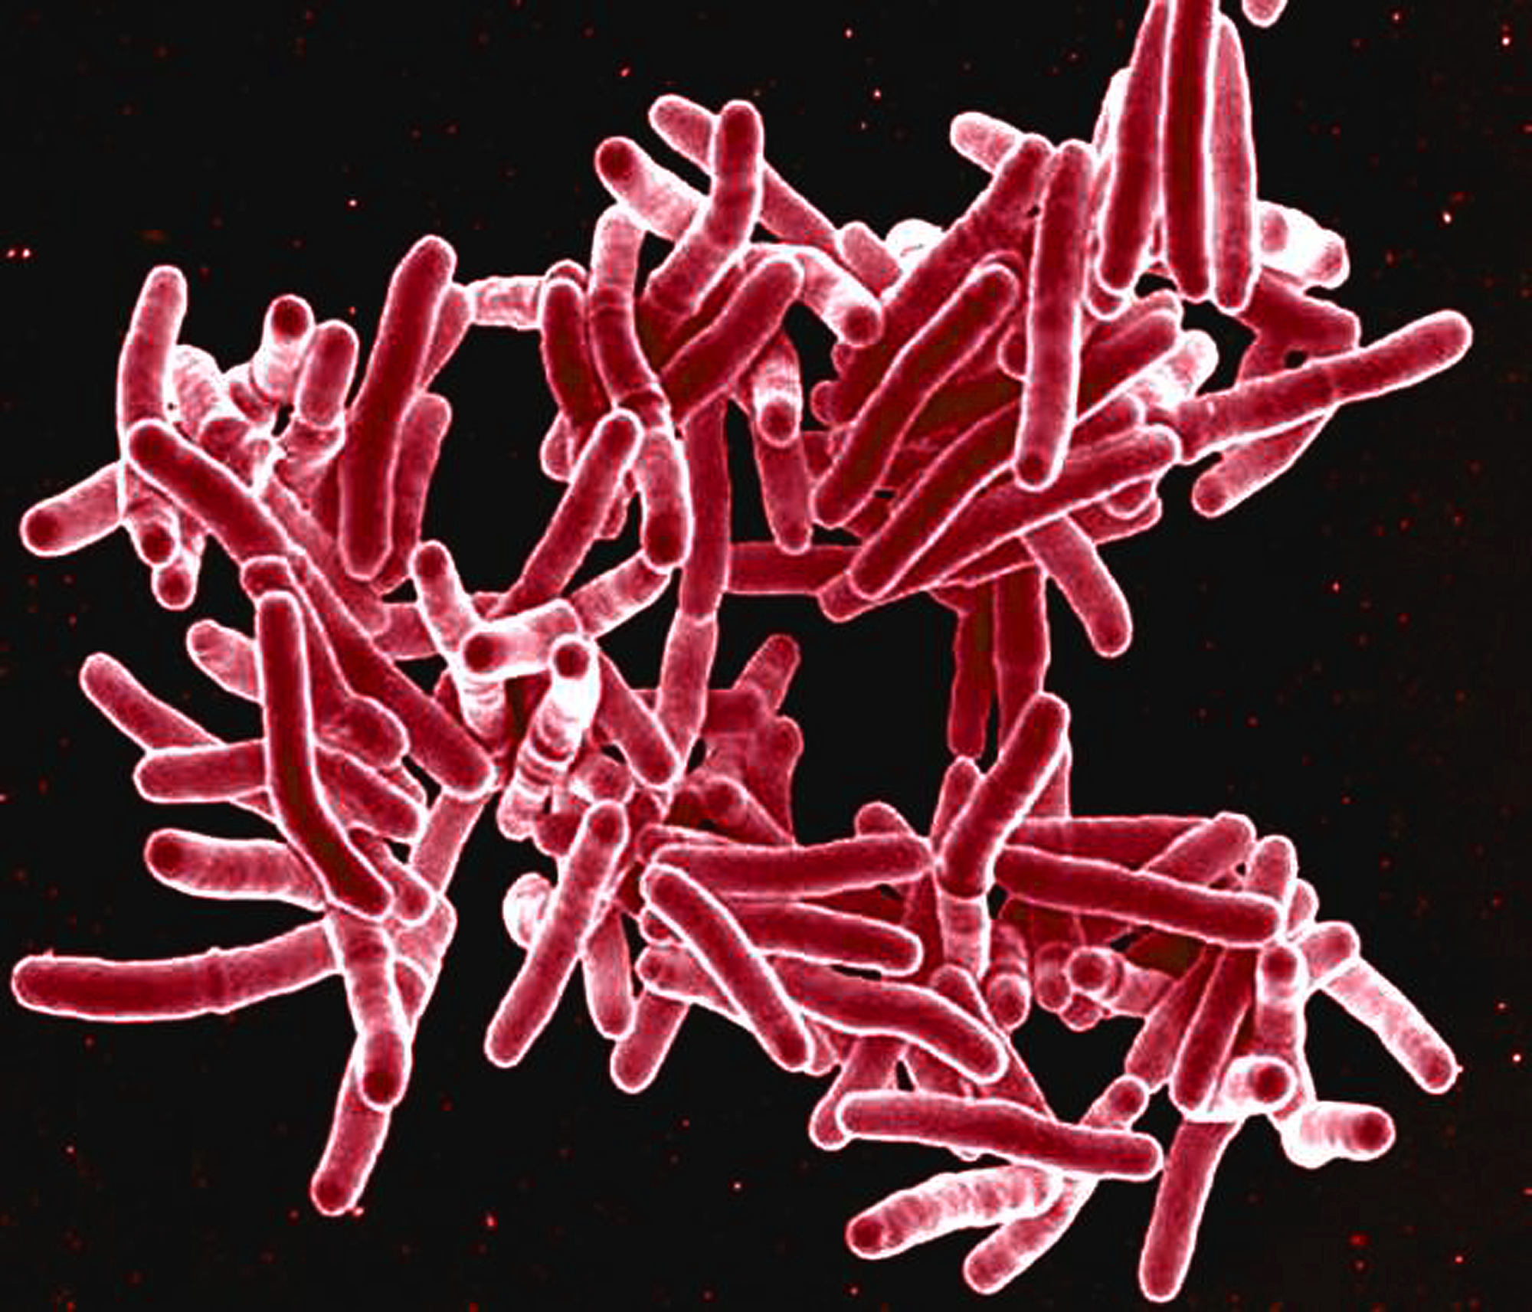
Background/Motivation
UV-C radiation is effective for inactivation airborne (aerosolized) respiratory pathogens
  Influenza virus
  Rhinovirus
  Measles virus
  SARS-CoV-2
  M. tuberculosis
  RSV
  HMPV
  Others
GUV systems can reduce the risk of respiratory illness transmission
Respiratory Syncytial
Virus (RSV)
Influenza
Virus
Rhinovirus
(Common Cold)
Measles
Virus
Human
Metapneumovirus
Virus (HMPV)
SARS-CoV-2
Mycobacterium
tuberculosis
Images from: CDC, NIH, University of Michigan,
The Week. Not to Scale!

Slide 3
Room as a Reactor
Process performance dictated by:
  Dose (fluence) distribution
    Fluence rate field
    Fluid mechanics
  Kinetics of inactivation(***) (fluence/response behavior)
These attributes are not well-defined for most germicidal UV (GUV) applications
Knowledge of these attributes will be key to development of risk-based design approaches
Reactor Performance:
Target Concentration in Treated Medium, C
Intrinsic Kinetics
UV Dose (Fluence)
Distribution
Influent Target
Concentration, C₀
Flow
Field
Fluence Rate Field
Reactor Geometry/
Configuration
Flow
Rate
Lamp Power
UVT
Image from: Blatchley (2023) Photochemical Reactors: Theory, Methods, and Applications of Ultraviolet Radiation, Wiley, New York.

Slide 4
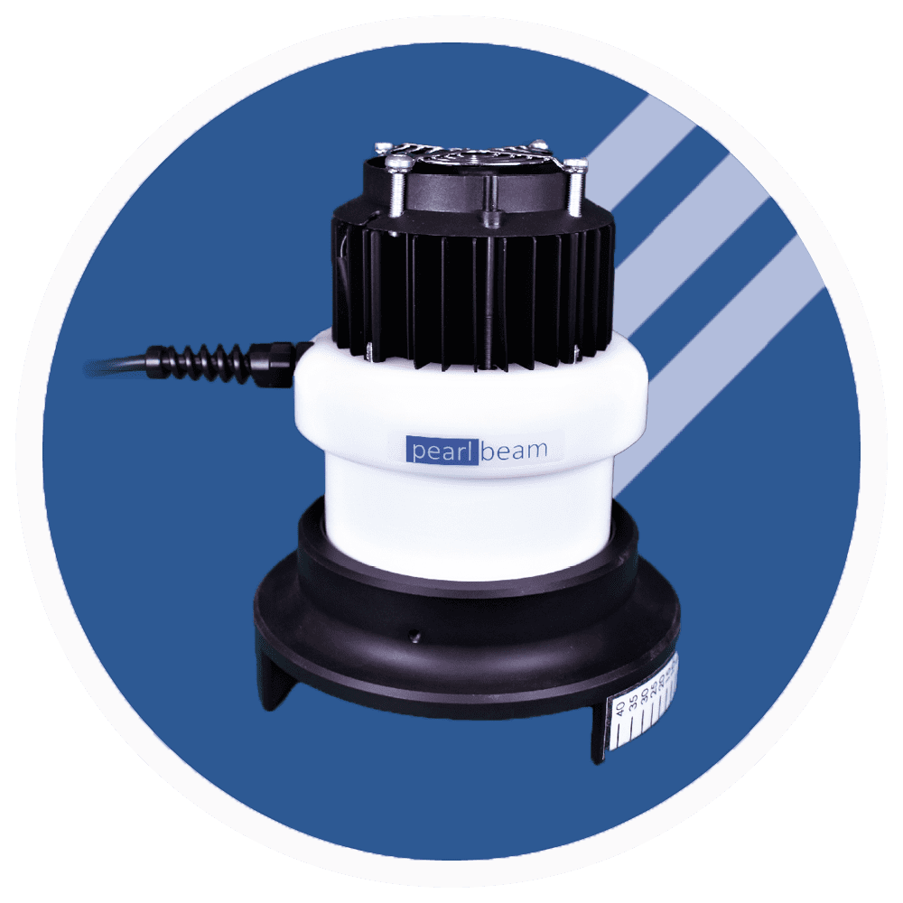
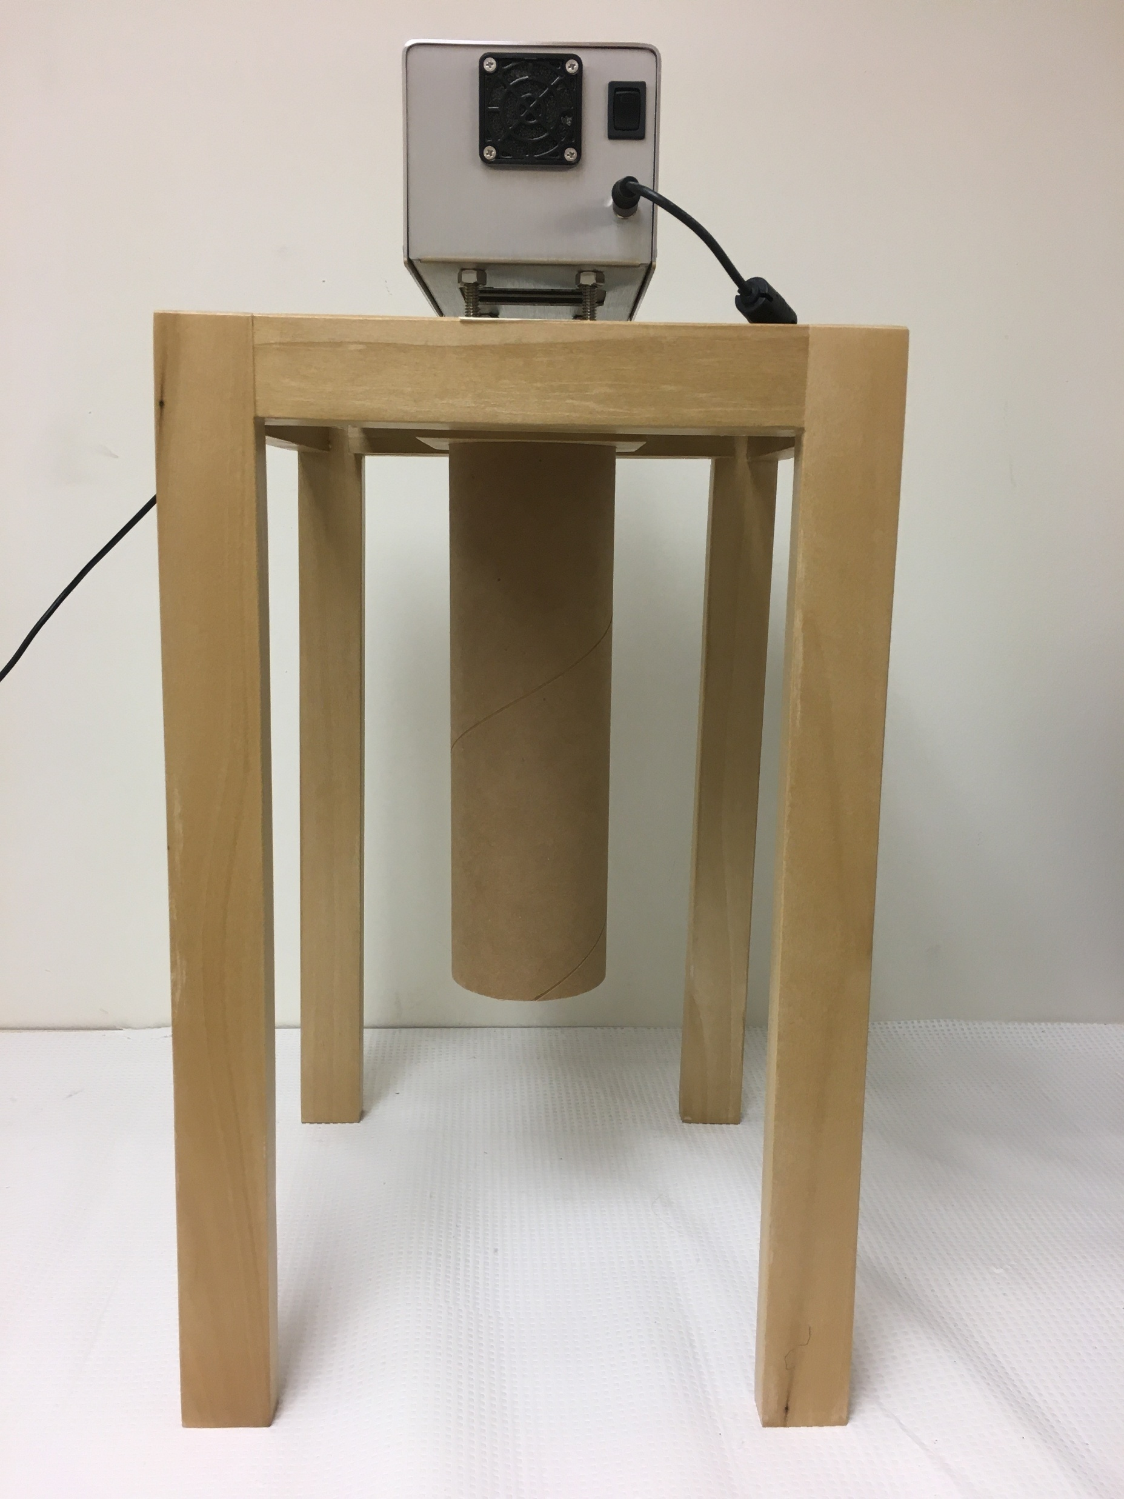
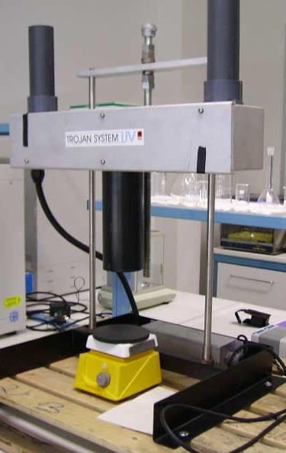
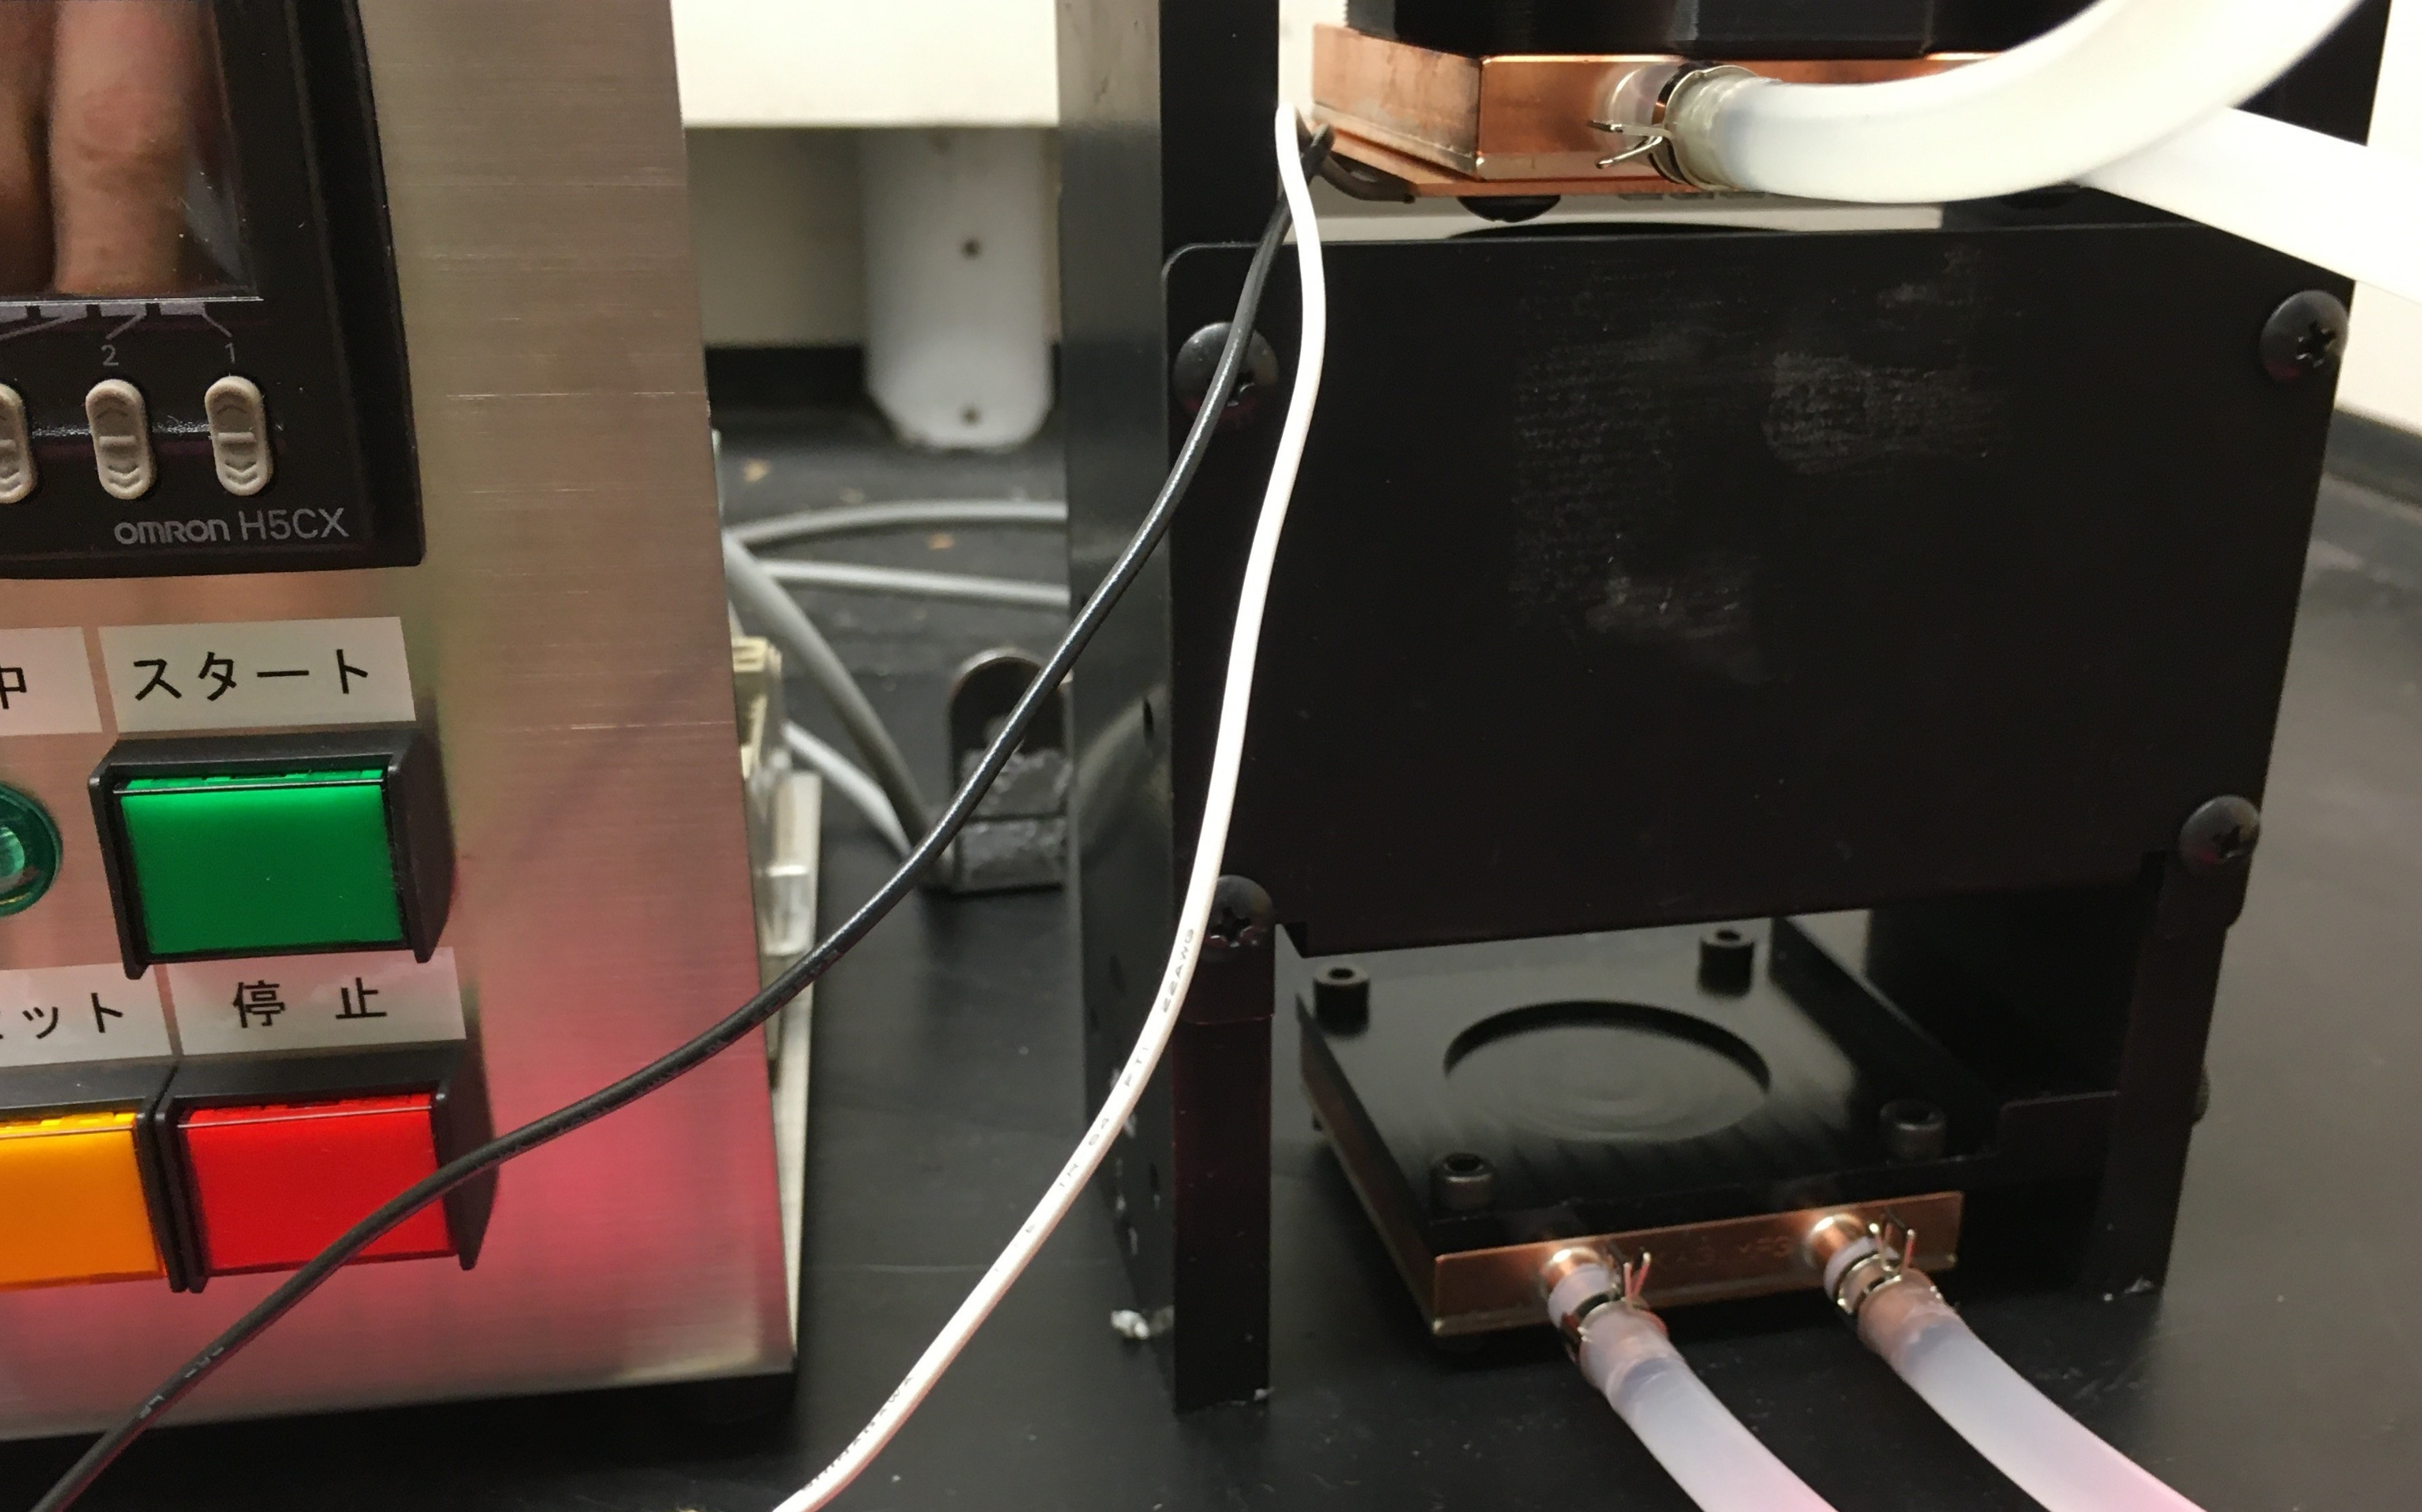
Need for a Standard Method
Well-defined device (collimated beam) and method for aqueous liquid suspensions (Bolton and Linden, 2003)
Standard for quantification of UV dose/response behavior (kinetics) with aqueous liquid suspensions
Database of reliable dose-response behavior (Malayeri et al., 2016)
Analogous apparatus/method does not exist for aerosols
  Dose (distribution) quantification
  No standard
Reports of aerosol-phase inactivation kinetics are highly variable

Slide 5
Project Goals
Develop and demonstrate device(s) to deliver accurately quantifiable fluence distribution
Develop and demonstrate method(s) to accurately quantify fluence-response behavior (UV inactivation kinetics) of aerosolized challenge agents
  Experimental methods
  Numerical methods
Make reactor(s) and method(s) widely available to be used as a standard

Slide 6
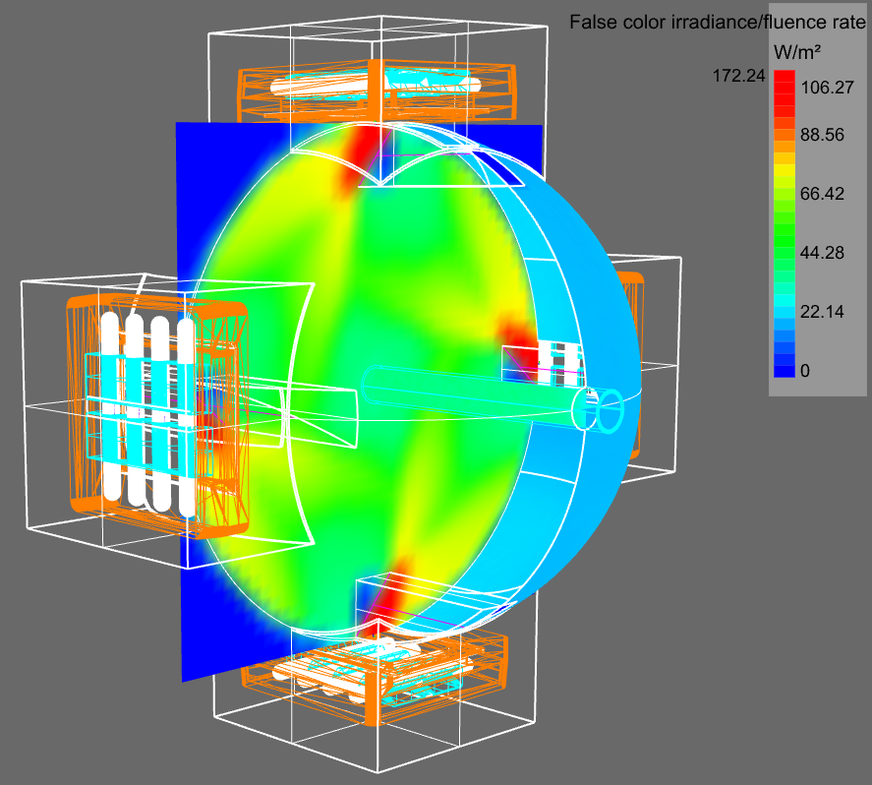
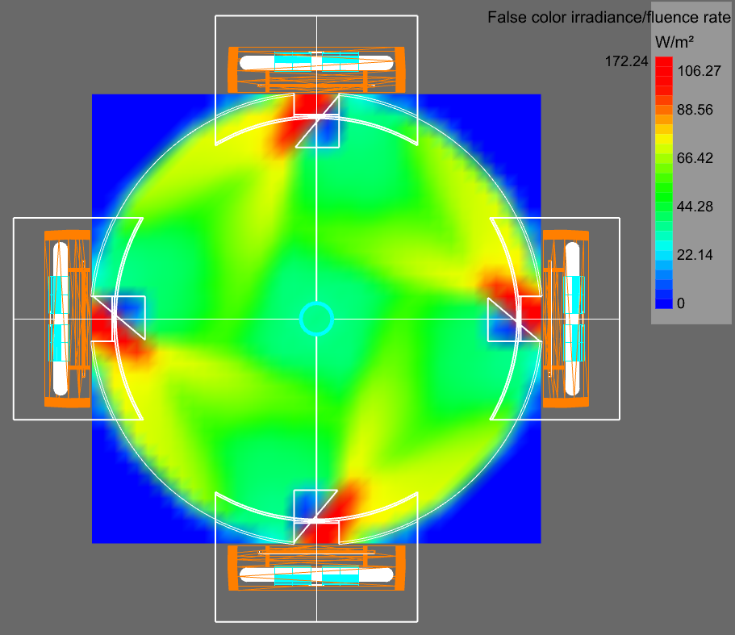
Original Design Concept:
Numerical Simulations (Ray Tracing)
Continuous flow
  Low challenge agent concentration in aerosol phase
  Require large sample volume
  Fluid flow in laminar regime
  Quantifiable fluence distribution
Integrating sphere
  Highly reflective interior surfaces
  Lamps positioned radially
  Cylindrical quartz transmission tube
  Exclusively interreflected radiation delivered to targets
  Highly uniform fluence rate field
Reactor attributes
  High fluence rate; spatially uniform
  Difficult to apply reflective material

Slide 7
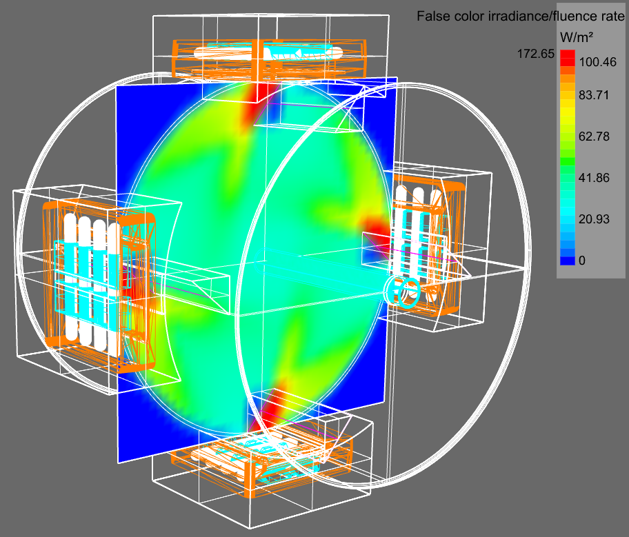
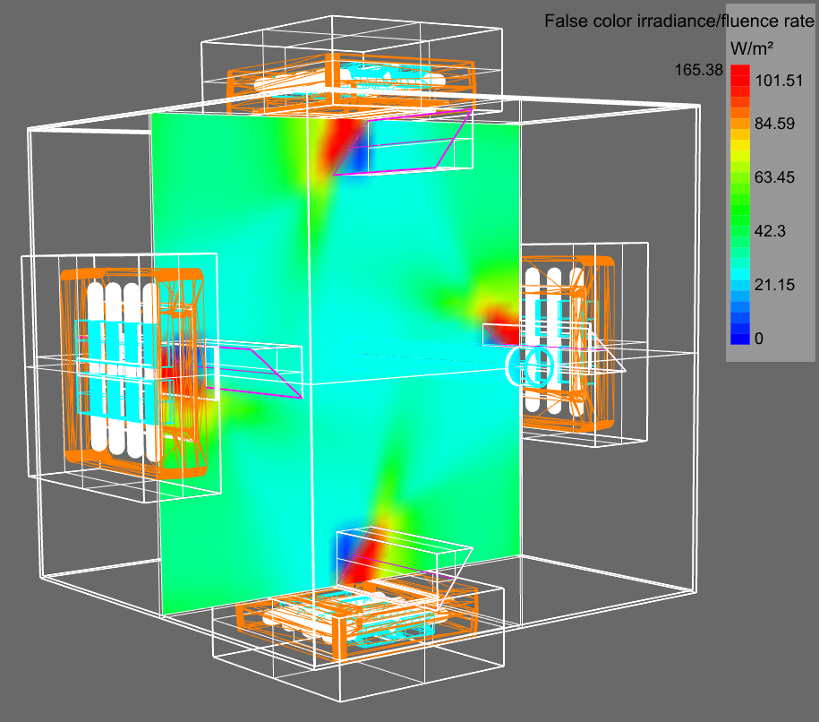
Alternative Designs
"Integrating Cylinder" (***)
Highly uniform fluence rate field
Simple fabrication
Reflective lining simplified
"Integrating Cube"
Highly uniform fluence rate field
Simple fabrication
Reflective lining simplified

Slide 8
Mark: add more images here to illustrate results of updated fluence rate field simulations

Slide 9
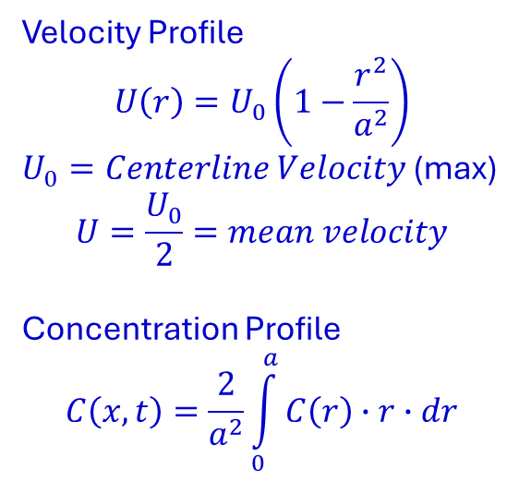
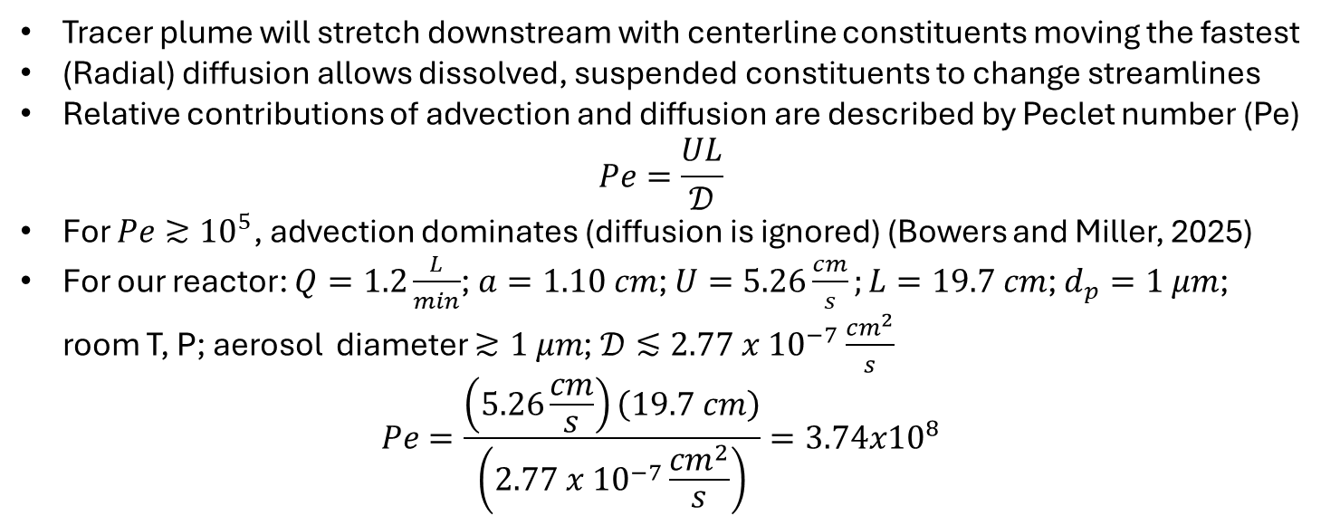
Definition Sketch: Transport Behavior for Laminar Flow in a Circular Tube (Taylor, 1953)
L
Velocity Profile
$$U\left(r\right)=U_{0}\left(1−\frac{r^{2}}{a^{2}}\right)$$
$U_{0}=Centerline Velocity$ (max)
$$U=\frac{U_{0}}{2}=mean velocity$$
Concentration Profile
$$C\left(x,t\right)=\frac{2}{a^{2}}\int_{0}^{a}{C\left(r\right)∙r∙dr}$$
Tracer plume will stretch downstream with centerline constituents moving the fastest
(Radial) diffusion allows dissolved, suspended constituents to change streamlines
Relative contributions of advection and diffusion are described by Peclet number (Pe)
$$Pe=\frac{UL}{𝒟}$$
For $Pe≳{10}^{5}$, advection dominates (diffusion is ignored) (Bowers and Miller, 2025)
For our reactor: $Q=1.2\frac{L}{min}$; $a=1.10 cm$; $U=5.26\frac{cm}{s};L=19.7 cm$; $d_{p}=1 μm$; room T, P; aerosol diameter $≳1 μm$; $𝒟≲2.77 x {10}^{−7}\frac{{cm}^{2}}{s}$
$$Pe=\frac{\left(5.26\frac{cm}{s}\right)\left(19.7 cm\right)}{\left(2.77 x {10}^{−7}\frac{{cm}^{2}}{s}\right)}=3.74x{10}^{8}$$

Slide 10
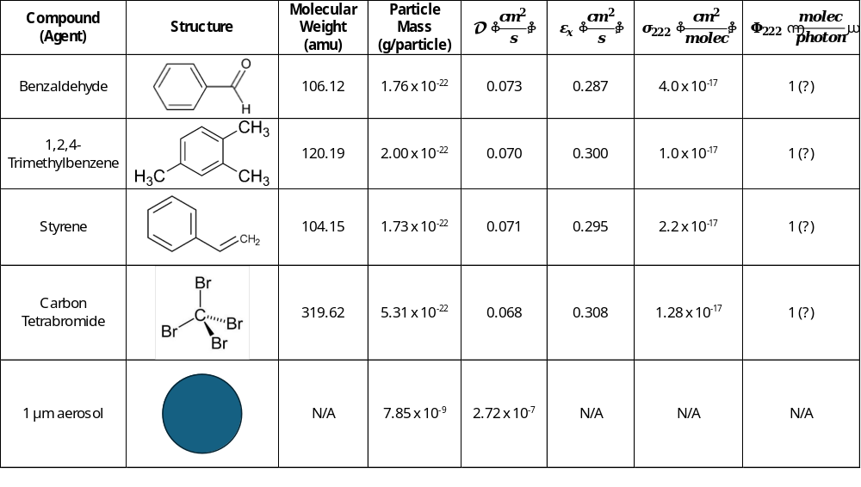

Properties of Challenge Agents
Room T
In Air
$$208\frac{{cm}^{3}}{min}$$
Assumed

Slide 11
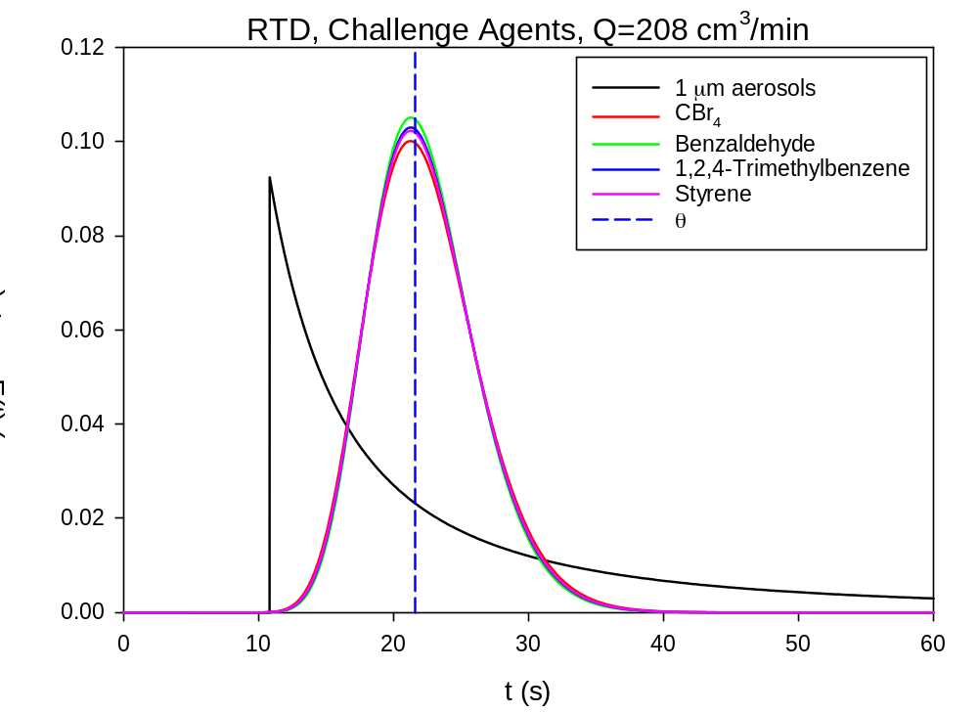
Transport Behavior in Circular Tube
Diffusivity of aerosols is ∼5 orders of magnitude smaller than gas-phase actinometer molecules
Diffusion (radial) of aerosols can be neglected in analysis of transport behavior (dominated by advection); diffusion of gases must be considered
Transport behavior of challenge agents will depend on diffusivity
  Aerosols are ∼non-diffusing
  Gas-phase actinometers are all very similar
Transport behavior must be accounted for in analysis of photochemical reactor behavior

Slide 12
Segregated Flow Model (SFM), Time Basis: Definition Sketch
Some fluid elements (batch reactors) have short residence (reaction) time
Some fluid elements (batch reactors) have long residence (reaction) time
RTD quantifies the distribution of residence (reaction) times
At steady-state, a sample of reactor effluent will be characterized by the RTD
SFM assumes no material transfer among fluid elements
∴Each fluid element behaves as a batch reactor
SFM accounts for effects of RTD on reactor performance

Slide 13
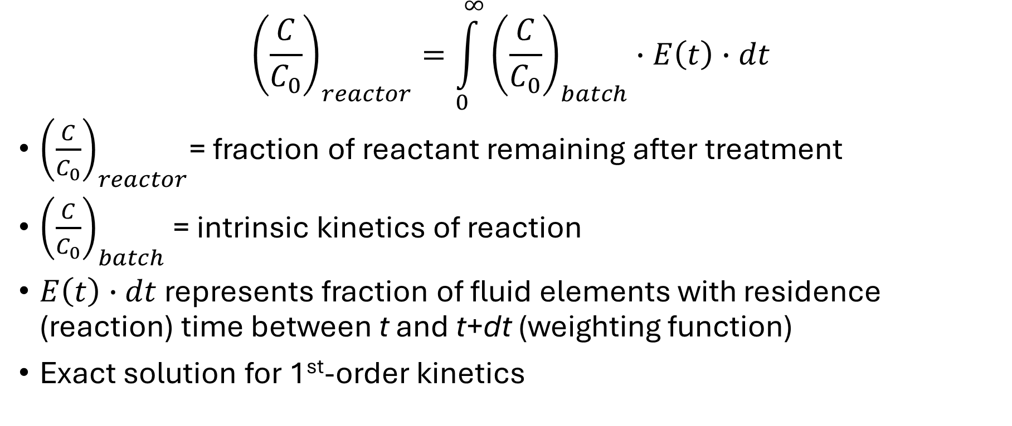
Chemical Reactor Performance
Segregated Flow Model
$${\left(\frac{C}{C_{0}}\right)}_{reactor}=\int_{0}^{∞}{{\left(\frac{C}{C_{0}}\right)}_{batch}∙E\left(t\right)∙dt}$$
${\left(\frac{C}{C_{0}}\right)}_{reactor}$= fraction of reactant remaining after treatment
${\left(\frac{C}{C_{0}}\right)}_{batch}$ = intrinsic kinetics of reaction
$E\left(t\right)∙dt$ represents fraction of fluid elements with residence (reaction) time between t and t+dt (weighting function)
Exact solution for 1st-order kinetics

Slide 14
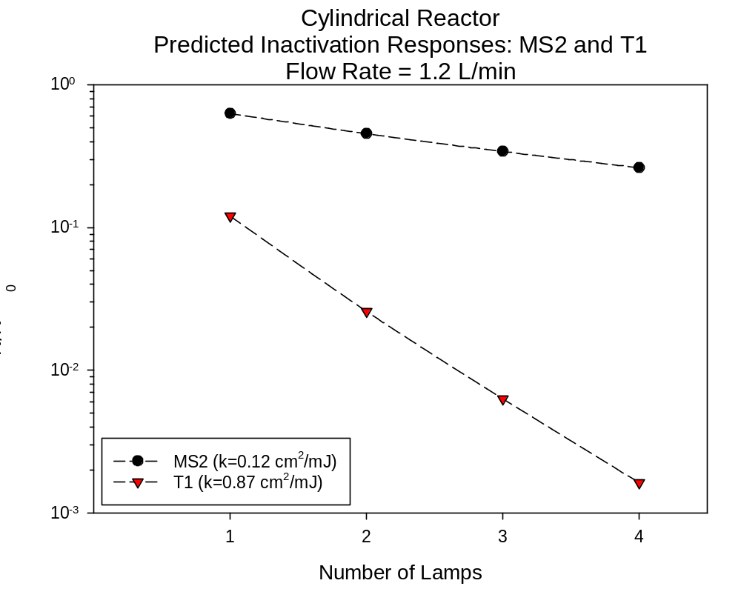

Slide 15
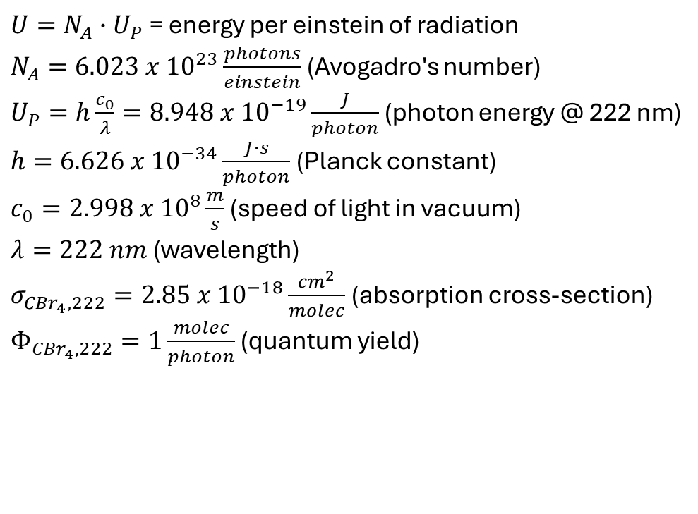
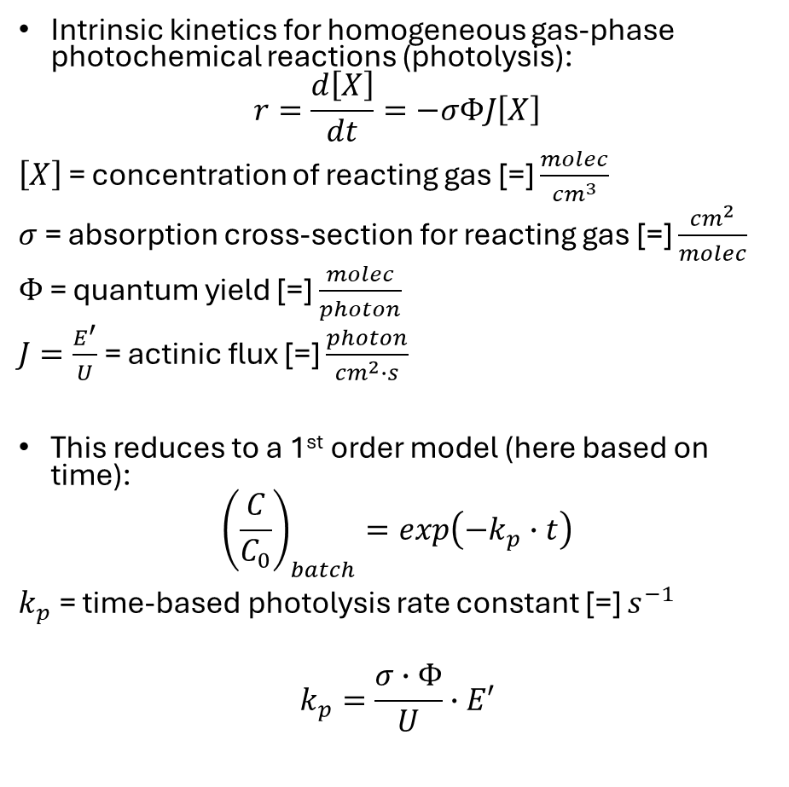
Intrinsic Kinetics for Actinometry:
Homogenous Gas-Phase Reactions
Intrinsic kinetics for homogeneous gas-phase photochemical reactions (photolysis):
$$r=\frac{d\left[X\right]}{dt}=−σΦJ\left[X\right]$$
$\left[X\right]$ = concentration of reacting gas [=] $\frac{molec}{{cm}^{3}}$
$σ$ = absorption cross-section for reacting gas [=] $\frac{{cm}^{2}}{molec}$
$Φ$ = quantum yield [=] $\frac{molec}{photon}$
$J=\frac{E^{′}}{U}$ = actinic flux [=] $\frac{photon}{{cm}^{2}∙s}$
This reduces to a 1st order model (here based on time):
$${\left(\frac{C}{C_{0}}\right)}_{batch}=exp\left(−k_{p}∙t\right)$$
$k_{p}$ = time-based photolysis rate constant [=] $s^{−1}$
$$k_{p}=\frac{σ∙Φ}{U}∙E′$$
$U=N_{A}∙U_{P}$ = energy per einstein of radiation
$N_{A}=6.023 x {10}^{23}\frac{photons}{einstein}$ (Avogadro's number)
$U_{P}=h\frac{c_{0}}{λ}=8.948 x {10}^{−19}\frac{J}{photon}$ (photon energy @ 222 nm)
$h=6.626 x {10}^{−34}\frac{J∙s}{photon}$ (Planck constant)
$c_{0}=2.998 x {10}^{8}\frac{m}{s}$ (speed of light in vacuum)
$λ=222 nm$ (wavelength)
$σ_{{CBr}_{4},222}=2.85 x {10}^{−18}\frac{{cm}^{2}}{molec}$ (absorption cross-section)
$Φ_{{CBr}_{4},222}=1\frac{molec}{photon}$ (quantum yield)

Slide 16
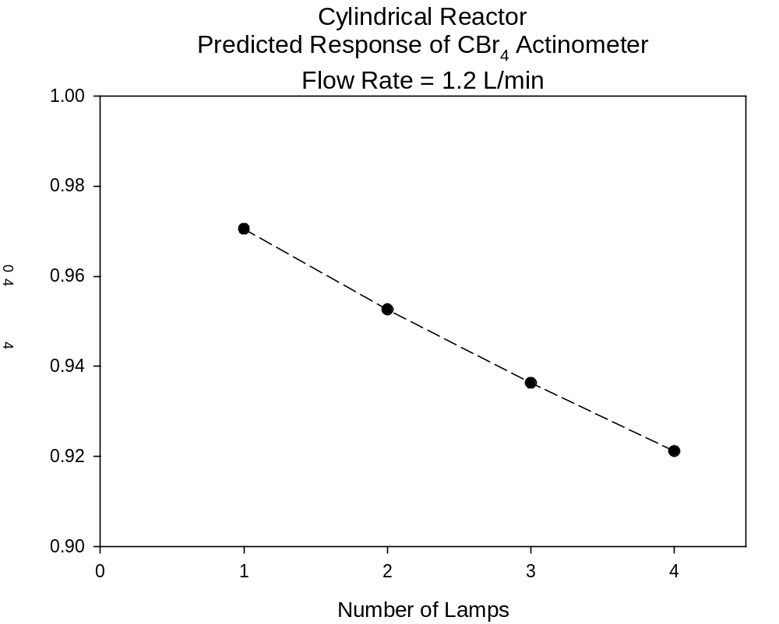

Slide 17
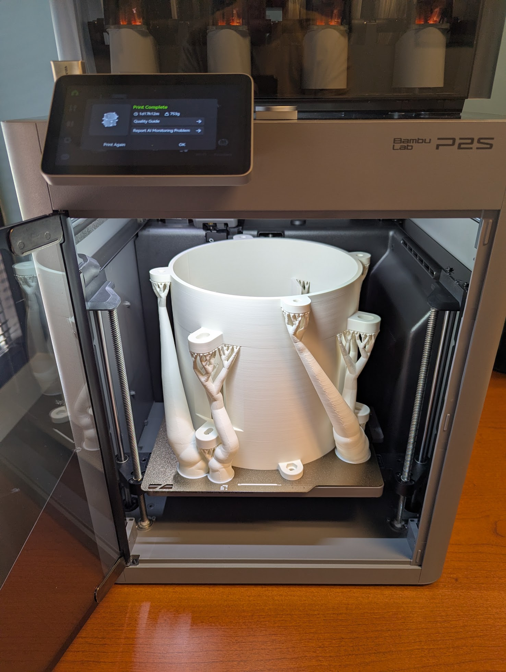
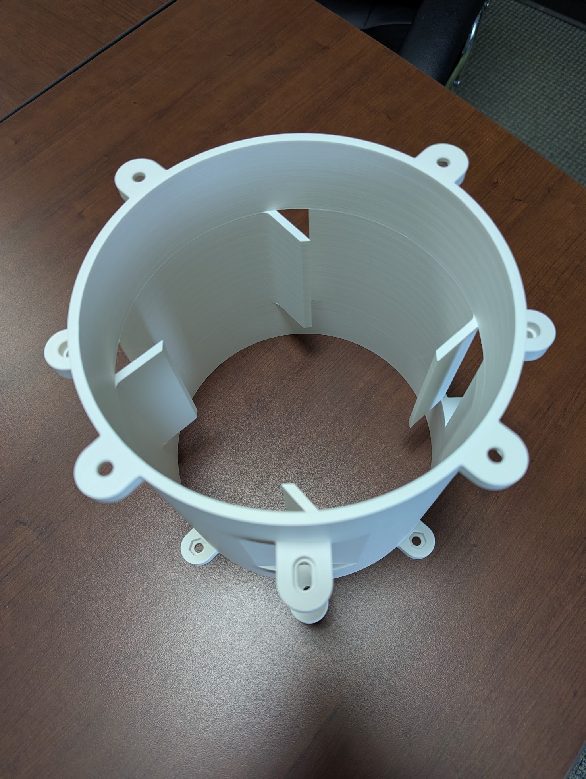
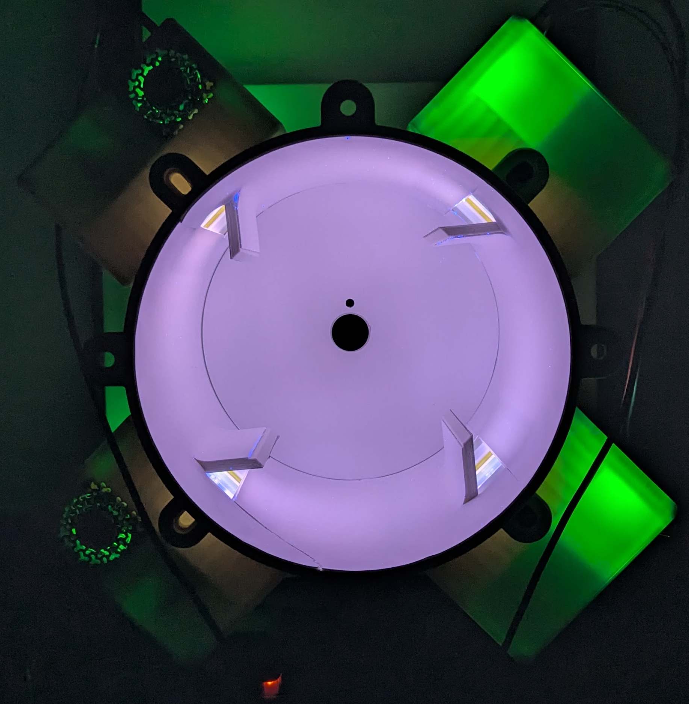
BLueprint Uniform Cylindrical Integrating Fluence Rate Reactor (BLUCIFRR) Production

Slide 18
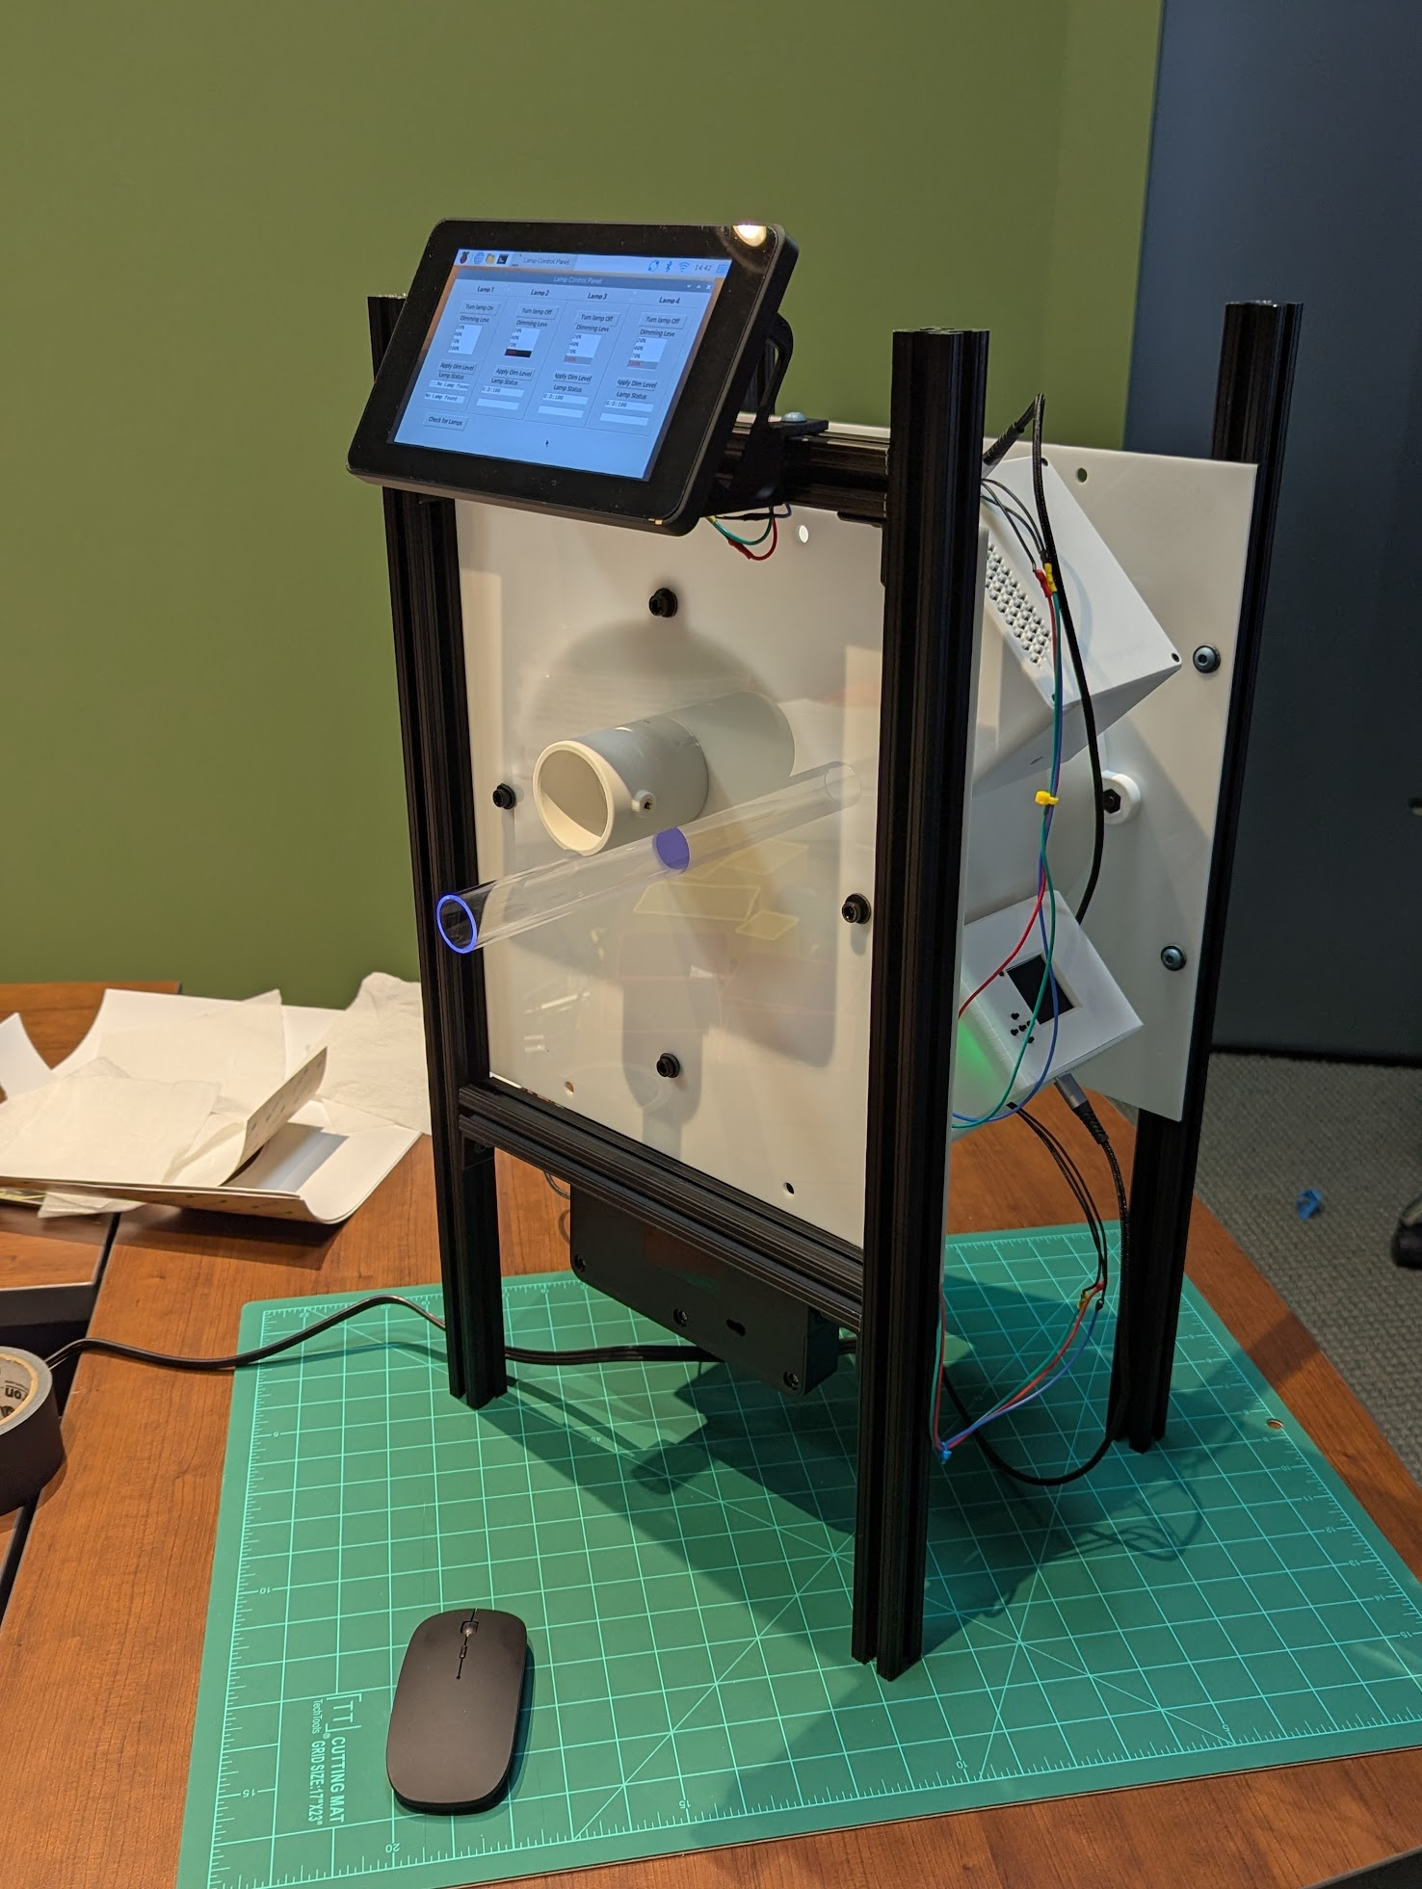
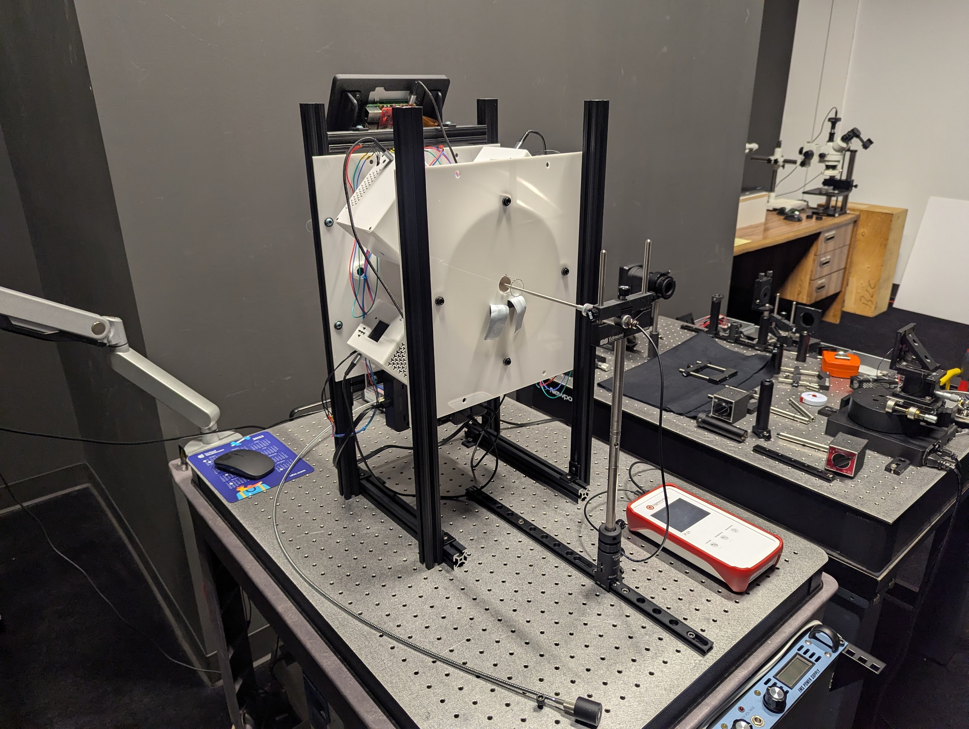
BLUCIFRR Prototype

Slide 19
Summary
Goal: develop reactor(s) and method(s) to accurately quantify UV inactivation kinetics for challenge agents in the aerosol phase
BLueprint Uniform Cylindrical Integrating Fluence Rate Reactor (BLUCIFRR)
  Essentially uniform fluence rate field
  Continuous flow operation: laminar flow in a circular tube
  Attributes allow accurate calculation of fluence (dose) distribution
  Reaction rate parameters are solved for by regression (fitting)
Applicable to aerosol-phase and gas-phase reactions
Reactor and methods available to anyone

Slide 20

Thank you! Questions?
Ernest R. Blatchley III
^{blatch@purdue.edu}

Slide 21
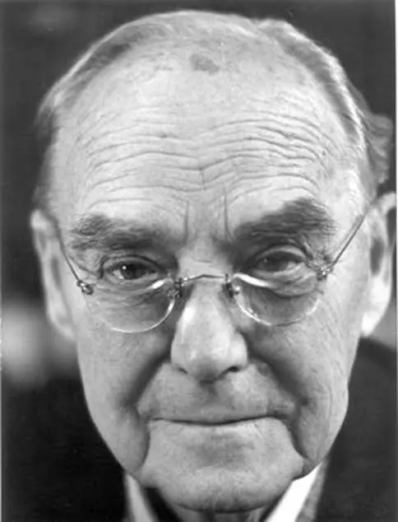
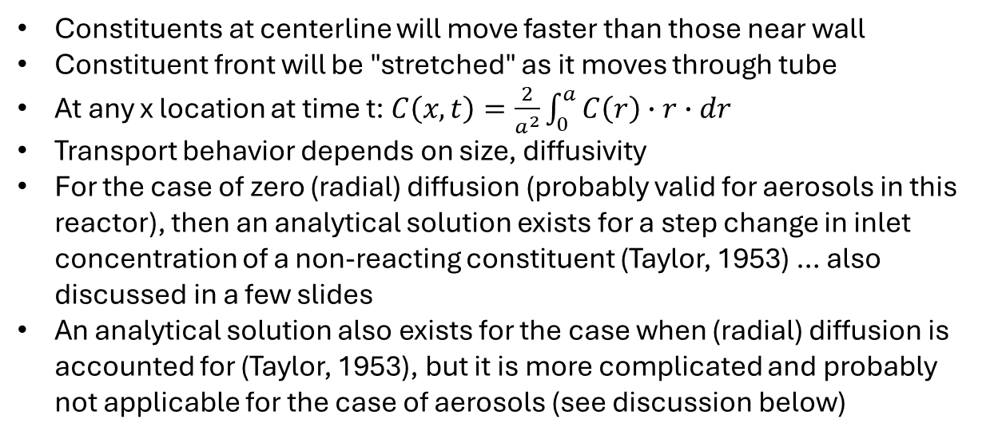
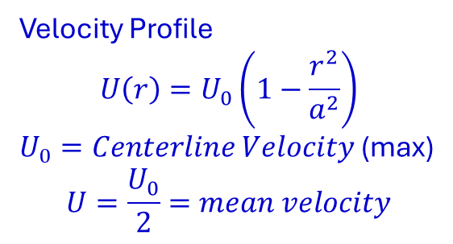
Transport Behavior of Suspended/Soluble Material Under Laminar Flow in a Circular Tube
r
a
x
U₀
L
Constituents at centerline will move faster than those near wall
Constituent front will be "stretched" as it moves through tube
At any x location at time t: $C\left(x,t\right)=\frac{2}{a^{2}}\int_{0}^{a}{C\left(r\right)∙r∙dr}$
Transport behavior depends on size, diffusivity
For the case of zero (radial) diffusion (probably valid for aerosols in this reactor), then an analytical solution exists for a step change in inlet concentration of a non-reacting constituent (Taylor, 1953) … also discussed in a few slides
An analytical solution also exists for the case when (radial) diffusion is accounted for (Taylor, 1953), but it is more complicated and probably not applicable for the case of aerosols (see discussion below)
Sir G.I Taylor
Velocity Profile
$$U\left(r\right)=U_{0}\left(1−\frac{r^{2}}{a^{2}}\right)$$
$U_{0}=Centerline Velocity$ (max)
$$U=\frac{U_{0}}{2}=mean velocity$$

Slide 22
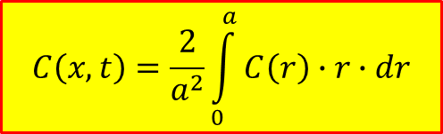
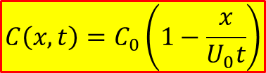
Hypothetical Tracer Test (No Diffusion)
Step Change in Inlet Concentration at t=0
C₀
t=0
r
$$C\left(x,t\right)=\frac{2}{a^{2}}\int_{0}^{a}{C\left(r\right)∙r∙dr}$$
L
$$C\left(x,t\right)=C_{0}\left(1−\frac{x}{U_{0}t}\right)$$
x
x=0
C₀
t=1
C₀
t=2

Slide 23
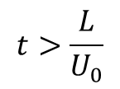
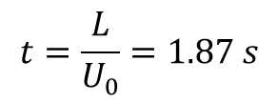
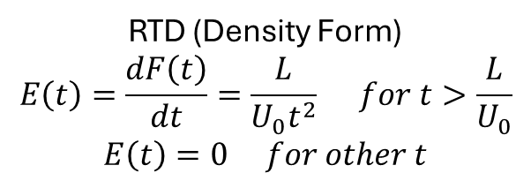
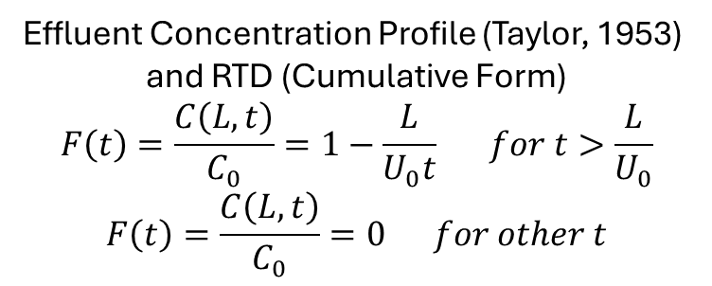
Tracer Emergence from Reactor
C₀
L
$$t=\frac{L}{U_{0}}=1.87 s$$
x=0
C₀
$$t>\frac{L}{U_{0}}$$
L
x=0
Effluent Concentration Profile (Taylor, 1953)
and RTD (Cumulative Form)
$$F\left(t\right)=\frac{C\left(L,t\right)}{C_{0}}=1−\frac{L}{U_{0}t} for t>\frac{L}{U_{0}}$$
$$F\left(t\right)=\frac{C\left(L,t\right)}{C_{0}}=0 for other t$$
RTD (Density Form)
$$E\left(t\right)=\frac{dF\left(t\right)}{dt}=\frac{L}{U_{0}t^{2}} for t>\frac{L}{U_{0}}$$
$$E\left(t\right)=0 for other t$$

Slide 24
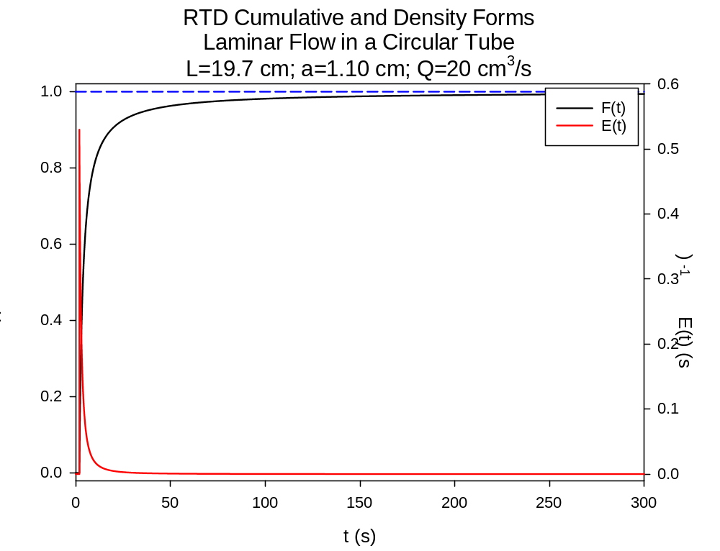
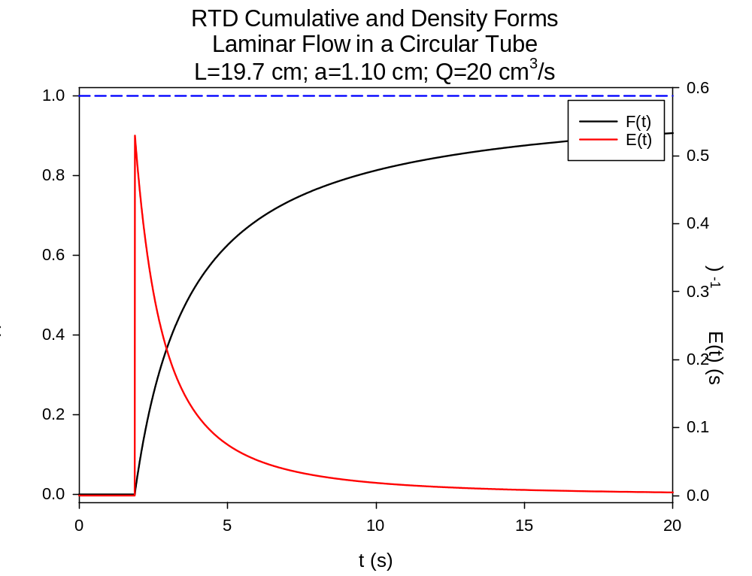

Slide 25
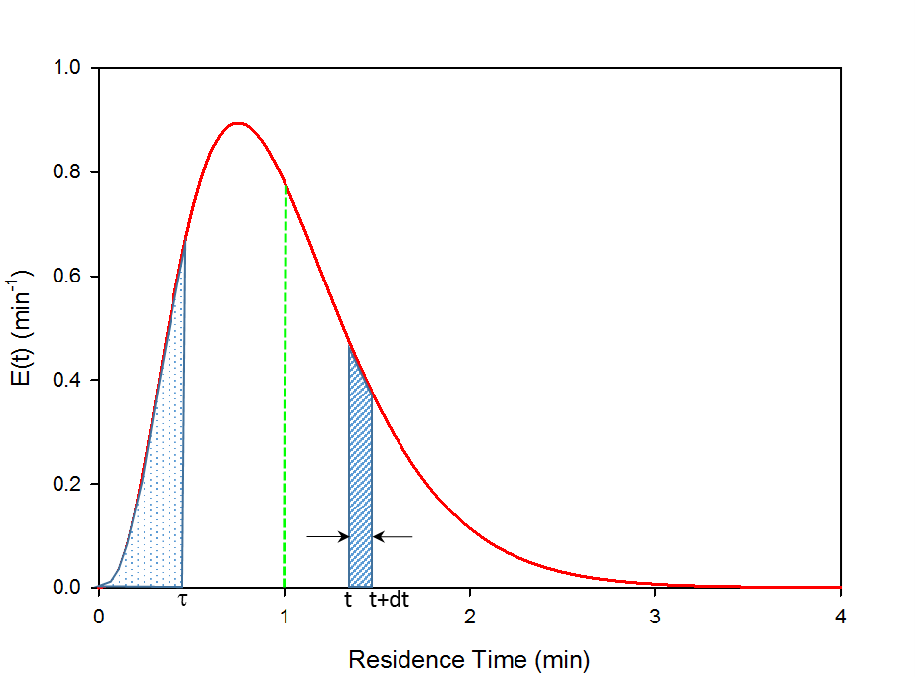
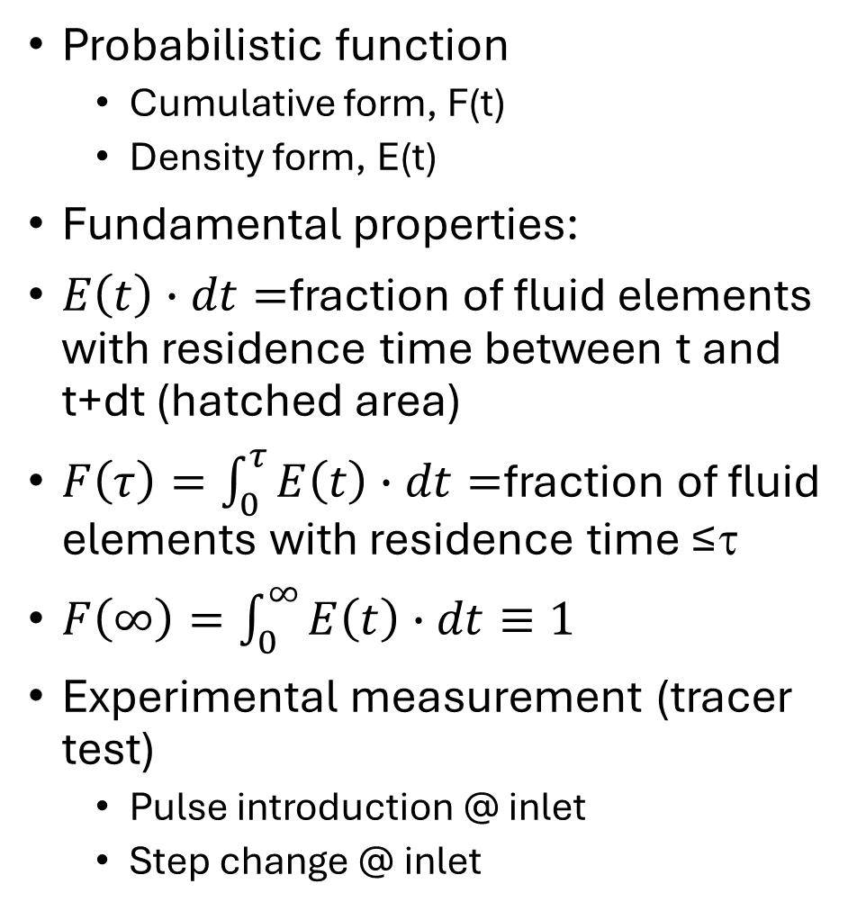
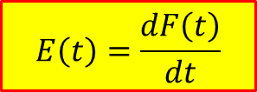
Residence Time Distribution Function (RTD)
Probabilistic function
  Cumulative form, F(t)
  Density form, E(t)
Fundamental properties:
$E\left(t\right)∙dt=$fraction of fluid elements with residence time between t and t+dt (hatched area)
$F\left(τ\right)=\int_{0}^{τ}{E\left(t\right)∙dt=}$fraction of fluid elements with residence time ≤τ
$F\left(∞\right)=\int_{0}^{∞}{E\left(t\right)∙dt≡1}$
Experimental measurement (tracer test)
  Pulse introduction @ inlet
  Step change @ inlet
$$E\left(t\right)=\frac{dF\left(t\right)}{dt}$$

